Slide 1


9
Introduction to Windows Programming
C# Programming: From Problem Analysis to Program Design
3rd Edition

Slide 2
Chapter Outline
Windows Applications
Windows Controls
Running Windows Applications
Windows Application Example
Windows Application Files

Slide 3
1. Windows Applications
Windows-based applications look different from console applications
Windows-based applications have a graphical user interface
Interface: front end of a program
Visual image you see when you run a program

Slide 4
Windows Applications
Graphical user interface (GUI) contain:
Forms (windows)
Buttons
Text boxes
Labels
Others (check boxes, radio buttons, etc.)

Slide 5
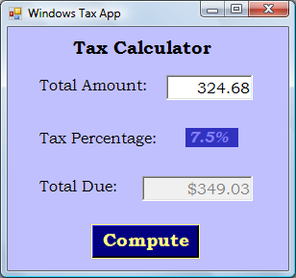
Graphical User Interface Example
Form
Text Box
Label
Button

Slide 6
2. Windows Controls
A Windows-based application has a Windows form
A form is an object
It is also called a control
It is a container where we can place other controls such as buttons, text boxes, labels, etc.

Slide 7
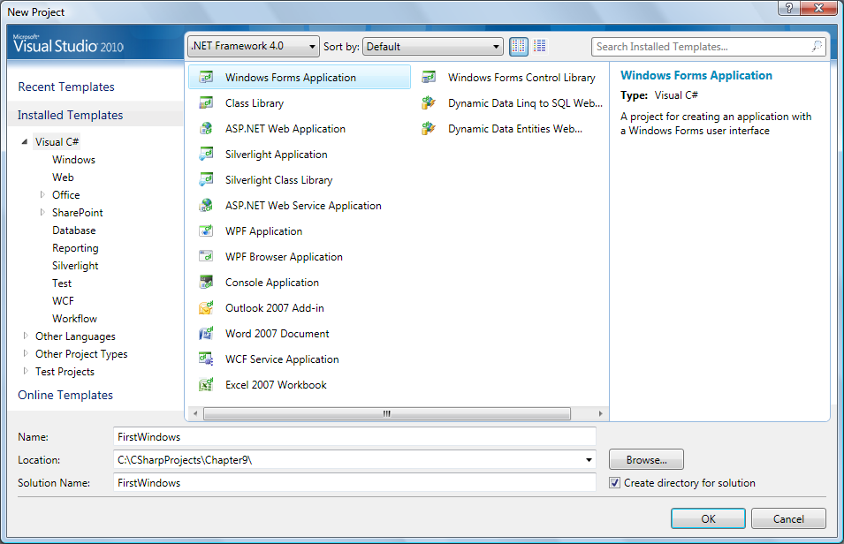
Creating Windows Forms

Slide 8
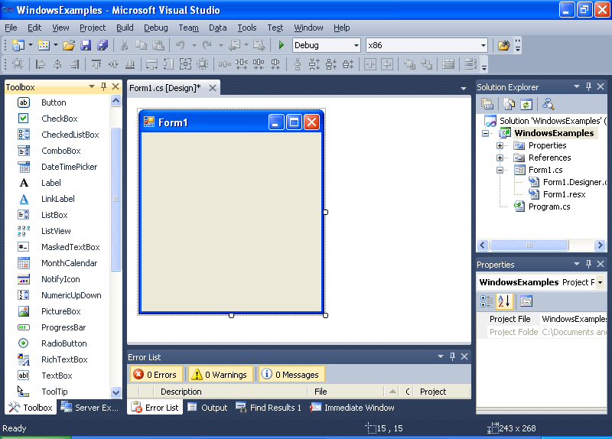
Creating Windows Forms
Form Designer View

Slide 9
Creating Windows Forms
Toolbox

Slide 10
Windows Controls
Controls are objects created from different classes
Example classes:
Form, Button, Label, TextBox, ComboBox, ListBox, CheckBox, RadioButton, etc.
Each class comes with its own predefined properties and methods

Slide 11
Adding Windows Controls
To place a control on the form, click on the control in the Toolbox, drag and drop it onto the form
You can move, resize, and delete controls
You can format controls to:
Align them
Make them same size
Adjust the horizontal and vertical spacing

Slide 12
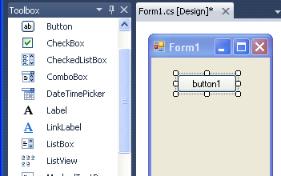
Adding Windows Controls
Button

Slide 13
Adding Windows Controls
Each Control class has large collection of properties and methods
The Properties Window in Visual Studio shows an alphabetized list of the properties
You can change a property value by clicking in the box and selecting or typing the new entry

Slide 14

Properties Window
Change Text property

Slide 15
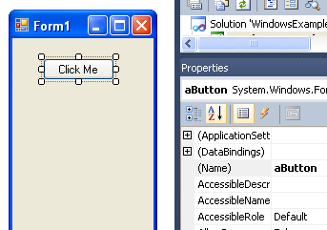
Properties Window
Change Name property

Slide 16
3. Running Windows Applications
When running console applications:
Each line in Main( ) executed sequentially and then the program halts
The program initiates interaction with the user
It requests the operating system to get data entered by the user using the ReadLine() method
It requests the operating system to output results through Write() or WriteLine() methods

Slide 17
Running Windows Applications
When running Windows-based applications:
Execution begins with first statement in the Main() method just as with console applications
But once it is launched, the Windows application goes through a process loop waiting for an event

Slide 18
Events
Event: notification from operating system that an action, such as the user clicking the mouse or pressing a key, has occurred
When the operating system gives the notification, the Windows applications will do something in response
After that, the application goes in a process loop again and waits until the next event

Slide 19
Events
Different controls can fire different events
Example:
Buttons – button-click event
Forms – form-load and form-closing events
You write event handlers that respond to the event

Slide 20
Event Handlers
Event handler: method that contains the code to execute when an event occurs
The event handler method code will do something as a response to the events

Slide 21
Event Handlers
Two things we need to do for events:
Need to register an event we are interested in
Need to associate an event handler method with an event
Visual Studio makes it easy to register an event and associate it with an event handler

Slide 22
Example: Button-Click Event
For a Button control, an event that we are interested in is the button-click event
To register the event, double-click the button on the form in the Form Designer View
Visual Studio automatically adds code and opens the Code Editor View

Slide 23
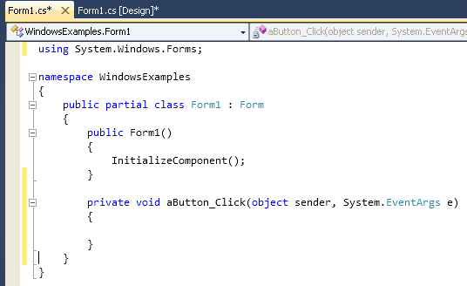
Example: Button-Click Event
Code Editor View

Slide 24
Example: Button-Click Event
The following code is added by Visual Studio when we double-click the button:
private void aButton_Click(object sender,
System.EventArgs e)
{
}

Slide 25
Example: Button-Click Event
aButton_Click is the name of the event handler method
aButton is the name of the button
Click is the name of the event

Slide 26
Example: Button-Click Event
We write the code in the body of the method
private void aButton_Click(object sender,
System.EventArgs e)
{
MessageBox.Show("You clicked the button!");
}
Note: Do not change or remove the parameters

Slide 27
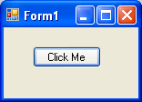
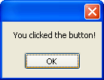
Example: Button-Click Event
Message Box appears when we click the button

Slide 28
Example: FormClosing Event
For a Windows Form control, an event that we are interested in is the form-closing event
To register the event and associate an event handler, first view the list of possible events for a Form control in the Properties Window by clicking on the Events icon
Next find the FormClosing event in the list of events and double-click on it

Slide 29
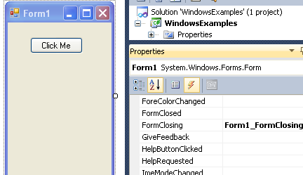
Example: FormClosing Event
Events icon
double-click here

Slide 30
Example: FormClosing Event
Visual Studio automatically adds the event handler method for the FormClosing event and opens the Code Editor View
private void Form1_FormClosing(object sender,
FormClosingEventArgs e)
{
}

Slide 31
Example: FormClosing Event
Form1_FormClosing is the name of the event-handler method
Form1 is the name of the Form control
FormClosing is the name of the event

Slide 32
Example: FormClosing Event
We write the code in the body of the method
private void Form1_FormClosing(object sender,
FormClosingEventArgs e)
{
MessageBox.Show("Good-Bye!");
}

Slide 33
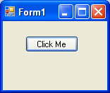
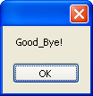
Example: FormClosing Event
Message Box appears when we click the ‘X’ to close the window

Slide 34
4. Windows Application Example
Circle application
2 versions
Console-based
Windows-based

Slide 35
Circle Application
using System;
class Circle
{
private double radius;
public double Radius
{
get { return radius; }
}
public Circle(double theRadius)
{ radius = theRadius; }
public double ComputeArea()
{ return Math.PI * Math.Pow(Radius, 2); }
}

Slide 36
Circle App – Console-based
using System;
class CircleConsoleApp
{
public static void Main()
{
double radius, area;
string input;
Console.Write("Enter circle radius: ");
input = Console.ReadLine();
radius = Convert.ToDouble(input);

Slide 37
Circle App – Console-based
Circle c = new Circle(radius);
area = c.ComputeArea();
Console.WriteLine();
Console.WriteLine("{0,-15} {1,7:F2}",
"Radius:", c.Radius);
Console.WriteLine("{0,-15} {1,7:F2}",
"Area:", area));
}
}

Slide 38
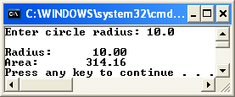
Circle App – Console-based

Slide 39
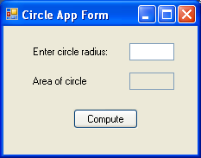
Circle App – Windows-based

Slide 40
Circle App – Windows-based
Form control
Properties: Name, Text
2 Label controls
Properties: Name, Text
2 TextBox controls
Properties: Name, Text, Enabled
Button control
Properties: Name, Text
Event of interest: Click

Slide 41
Circle App – Windows-based
CircleAppForm
lblRadius
tbxRadius
lblArea
tbxArea
btnCompute

Slide 42
Circle App – Windows-based
Control | Property | Value
CircleAppForm | Name | CircleAppForm
lblRadius | Name | lblRadius
lblArea | Name | lblArea
tbxRadius | Name | tbxRadius
tbxArea | Name | tbxArea
btnCompute | Name | btnCompute

Slide 43
Circle App – Windows-based
Control | Property | Value
CircleAppForm | Text | Circle App Form
lblRadius | Text | Enter circle radius:
lblArea | Text | Area of circle
tbxArea | Enabled | False
btnCompute | Text | Compute

Slide 44
Circle App – Windows-based
using System; // must have this
using System.Windows.Forms; // must have this
// do not modify these lines
namespace CircleWindowsApp // may be different
{
public partial class CircleAppForm : Form
{
public CircleAppForm()
{
InitializeComponent();
}

Slide 45
Circle App – Windows-based
private void btnCompute_Click(
object sender, EventArgs e)
{
// add these lines in the method body
double radius, area;
string input, result;
input = tbxRadius.Text;
radius = Convert.ToDouble(input);
Circle c = new Circle(radius);
area = c.ComputeArea();

Slide 46
Circle App – Windows-based
result = String.Format("{0:F2}", area);
tbxArea.Text = result;
}
}
}

Slide 47
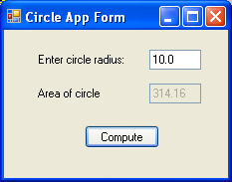
Circle App – Windows-based

Slide 48
5. Windows Application Files
Visual Studio separates the code for Windows applications into three files
When a new Windows Application type project is created, the default file names are
Form1.cs
Program.cs
Form1.cs actually consists of 2 files:
Form1.cs
Form1.Designer.cs

Slide 49
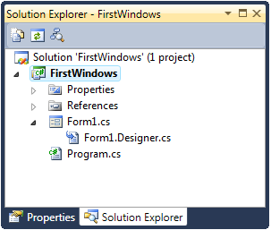
Windows Application Files

Slide 50
Program.cs
Program.cs contains the Main( ) method
Execution begins in the Main( ) method
The Main( ) method calls the Run( ) method which places the application in process loop
Do not modify the contents in this file

Slide 51
Program.cs
using System;
using System.Windows.Forms;
namespace FirstWindows
{
static class Program
{
. . .
static void Main()
{
. . .
Application.Run(new Form1());
}
}
}

Slide 52
Form1.cs
Form1.cs and Form1.Designer.cs both include partial class definitions for the Form1 class
Form1.cs contains the event handler methods – you add the code in the method bodies
Form1.Designer.cs holds auto generated code - do not modify its contents

Slide 53
Form1.cs
using System;
using System.Windows.Forms;
namespace FirstWindows
{
public partial class Form1 : Form
{
public Form1()
{
InitializeComponent();
}
// event handlers will be added here
}
}

Slide 54
Form1.cs
Note: Need to include:
using System.Windows.Forms;
Note: Class heading definition:
public partial class Form1 : Form
shows Form1 is a subclass of Form or Form1 is derived from Form

Slide 55
Form1.Designer.cs
namespace FirstWindows
{
partial class Form1
{
private Button aButton;
. . .
private void InitializeComponent()
{
aButton = new Button();
aButton.Name = "aButton";
aButton.Text = "Click Me";
. . .
}
}
}

Slide 56
Form1.Designer.cs
The code in this partial class defines the controls used in the Windows application as instance variables
The InitializeComponent() method contains code to create all the controls used and set their properties

